Slide 1
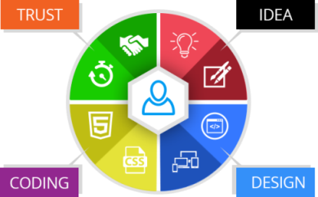

A Mini Project on DYANAMIC PORTALS FOR WEB APPLICATIONS
B.Shashidhar
15841A1206
Aurora’s Technological and Research Institute
Dept. of I.T
Project Guide: V. Madhavi

Slide 2

Index
Introduction
Abstract
Existing System & Problems
Proposed System & Solutions
Modules
Software Requirements
Hardware Requirements
Use Case Diagrams
Software Test Reports
Execution
Android App View
Internship Duration
Conclusion

Slide 3
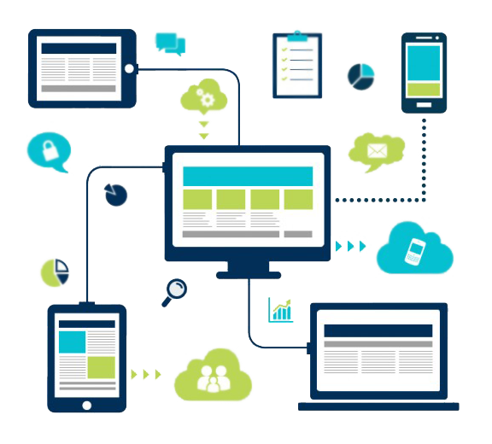
Introduction
A web application is a program that runs on a computer with a web server, while its users interact with it via a web browser or similar user agent.
Example
Web Applications vs. Native Applications.
Fetching Static Content.
Server-Side Dynamic Content.
Client-Side Processing.

Slide 4

Dynamic Portals
A Dynamic web portal is a specially designed website that brings information from diverse sources, like emails, online forums and search engines, together in a uniform way. Usually, each information source gets its dedicated area on the page for displaying information (a portlet); often, the user can configure which ones to display. Variants of portals include mashups and intranet "dashboards" for executives and managers.

Slide 5
Abstract
The Revolution has been changed from last few years the number of internet users increasing rapidly and new technologies came into existence people changing their move to smart phones with high speed internet are those applications which we are using secured or not and does our application that we built is working flexible in all devices with high security. The project “Dynamic Portals for Web Applications” deals with the development, management, and maintenance and marketing of the web applications and as a reference to any kind of audience. The website will be a dynamic one used as portal to all required information regarding the organization and its functions. The website will not only make it easier for the user to understand the organization’s aims and objectives, along with information about the services offered by the company.

Slide 6
Existing System
The websites are designed such a way that there will be a requirement of developer for each single operation which is leading to high developing cost even there is small updates in the websites. The sites which are building are not user friendly as we are growing with technology the usage of internet become more in day to day life. More number of people using internet through mobiles but the existing website are not responsive and user friendly which leads to more data consumption. Security is a critical issue in this rapidly advancing technological era, with new problems cropping up on a regular basis. Many existing websites are poorly in secured, being vulnerable to simple exploits such as SQL Injection, Phishing, and Cross Site Scripting etc.

Slide 7

Problems
Inconsistency
Heavy Load on Server
Multiple Pages for Single Operation
High Operational Cost
Less Efficiency
Security Issues
Unwanted Storage
Communication
No Responsiveness
No Usage of New Technologies

Slide 8
Proposed System
The implementation of this project will provide a dynamic portal to the company’s or e-commerce websites where they can add, update, delete the products information and change the prices accordingly to the market demand and also communication between the client and user makes more efficient/faster. Getting the statistics of the different products and reviews are directly provided to the user in graphical or pie charts format which makes e-commerce more profitable. Security is the main important criteria in any kind of applications where the user data will be stored securely without any attacks. The Security in Dynamic web portals is very high. They are encrypted with various algorithms and these websites are totally secured for all type of online transactions with user friendly interface. The application are built with advance concepts like PDO’s which will be secured for SQL Injection, Phishing, and Cross Site Scripting etc.

Slide 9
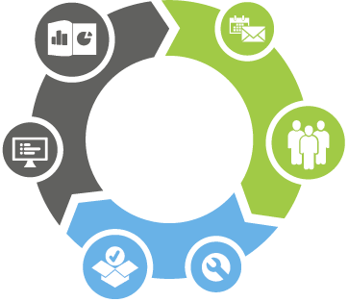
Solutions
Less Load on Server
Single Page for Multiple Operations
Build Once and Use
More Efficiency
No Security Issues
Easy Way for Communication
Responsiveness
Flexibility
New Technologies
Website as Mobile Application

Slide 10

Modules
Home Page
Book Now
About Us
Our Services
Our Process
Contact Us
Admin Login
Portal Homepage

Slide 11
Software Requirements
Web Presentation:
HTML
CSS
Bootstrap (CSS framework)
Client Side Scripting:
JavaScript
Ajax
J-Query
Server Side Scripting:
Advance PHP
Database:
Inno DB
Maria DB
Query Processing Language:
SQL
Hosting Platform:
Go daddy

Slide 12

Hardware Requirements
Processor: Intel i3
RAM Capacity: 2GB
Hard Disk: 160GB
Any Operating System

Slide 13
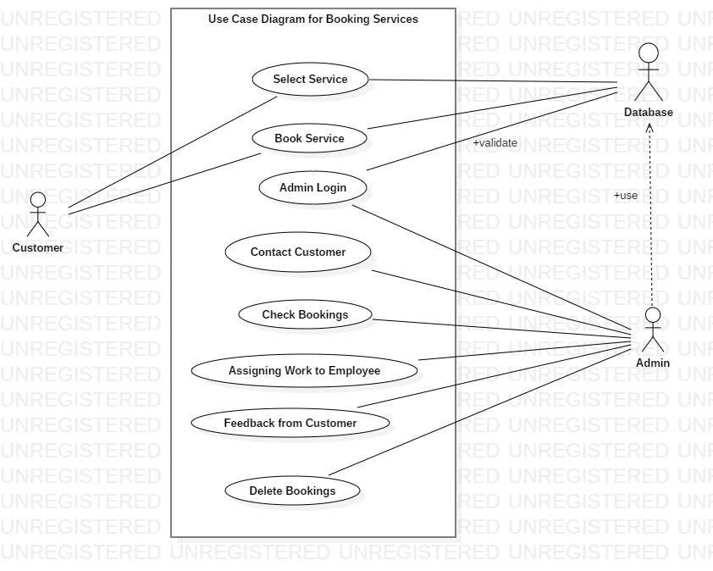
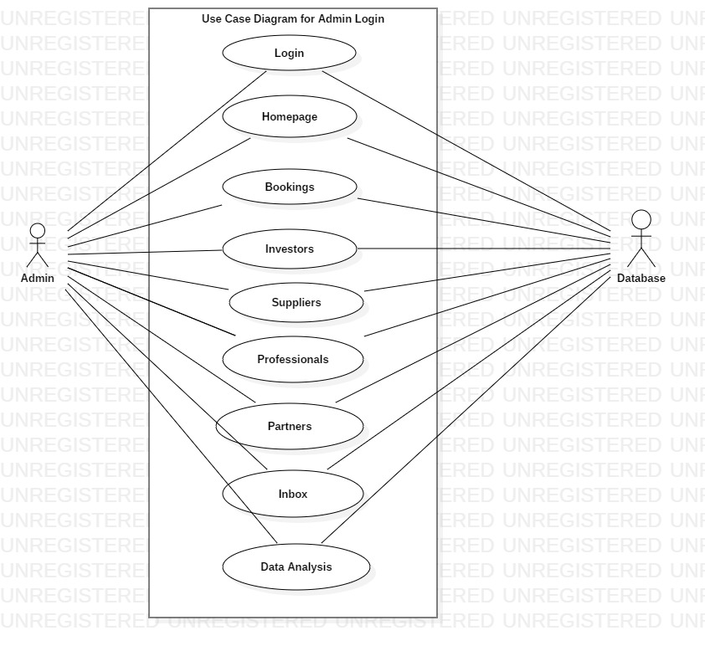
Use Case Diagrams

Slide 14

Web Application Testing
Functionality Testing
Usability Testing
Interface Testing
Database Testing
Compatibility Testing
Performance Testing
Security Testing
Crowd Testing

Slide 15
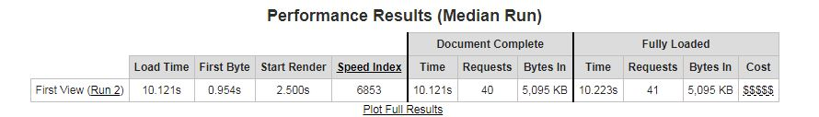
Testing Reports

Slide 16
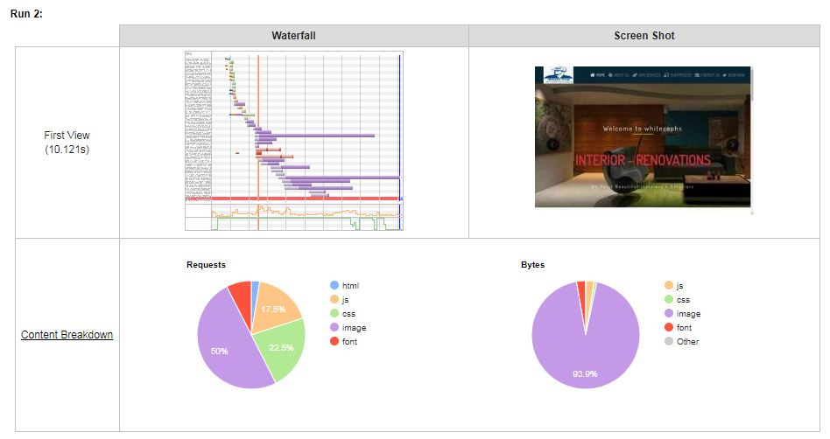

Slide 17

Execution
http://localhost/whitecap/
OR
http://whitecaphs.com/

Slide 18

Android Studio Web View
Web View is a view that display web pages inside your application. You can also specify HTML string and can show it inside your application using Web View. Web View makes turns your application to a web application.

Slide 19
Internship Duration & Benefits
Duration: 1-Month 15 Days.
Total Projects Worked On: 3 (Both Front End & Back End).
Technologies Known: HTML, CSS, JS, J-Query, PHP.
Technologies Learned: Bootstrap, Ajax, Basic Angular, PHP with Code Igniter.
Digital Media Marketing: SEO, SMO, SMM.
Other Experiences Gained: How Real Time Projects Can be Handled.

Slide 20

Conclusion
The delivered prototype can build a new solutions for sever response problems and fast accessing of website content. Data collection can be done without any help of third party software’s which are used for communication and statistics. Less need of memory and good complexity with high efficiency as well as well structured programming can lead to good software development.

Slide 21

THANK YOU
“First, Solve the Problem then, Write the Code.”

